Slide 1
Introduction to PnP Transformation Process
Vesa Juvonen
Senior Program Manager
Office 365, Microsoft
Notes:
Introduction to the PnP Transformation Process

Slide 2
Developer vision
USERS
DATA
HTML
Notes:
Our Office 365 developer vision focuses on the Users’ experience and their data. As a developer you can bring your applications into their user experience. With over 1.2+ billion users of Office Worldwide, this is a huge opportunity to provide a window into your applications. As well as being able to connect into their data and add intelligence to your applications. There are currently 850 million events created a month and a total of 470Pb+ of data stored in the service that can add value to for our Users’.

Slide 3








Why transition to SharePoint app/add-in model?
IT Pro’s
Scalable Solution
Align with service roadmap
Agile and faster deployment
You control release process
Cloud Enabled
Developers
Remote APIs
Cloud enabled
Cross-Device
Aligning with roadmap
Security
Notes:
Full trust solutions have implications on Disaster Recovery Model
Full trust solution deployments cause downtime
Full trust solutions have to be closely analysed and “trusted”
Sandbox solutions are deprecated

Slide 4

Why would you take advantage of the PnP Transformation process?
Modernize your custom SharePoint applications
Take advantage of new features and benefits of the standard SP app/add-in model
Enhance your existing custom solutions by leveraging the power of the SP app/add-in model
Leverage available community IP and expertise
SP app/add-in model is recommended customization pattern for Office 365 and for on-premises
Notes:
High level benefits of the process and reasoning for transition.

Slide 5

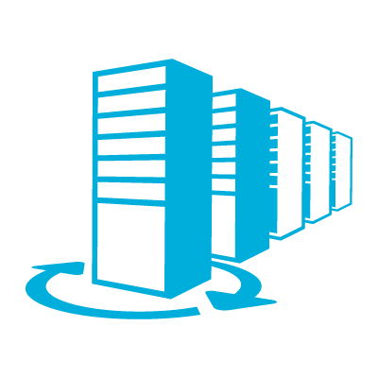

Ready to use proven process guidance
Help on messaging around transformation
Enterprise-grade cloud
Essential productivity services
Benefits of the PnP transformation process materials
Assist getting customizations cloud ready
Provide insights on needed actions
Flexibility and choice
Familiar and easy

Slide 6
SharePoint Customization Recommendations
Full trust code or farm solutions are not recommended
SP app / add-in model recommended also for on-premises
Provider hosted add-ins as recommended approach
Provider hosted add-ins hosted in Azure for Office 365
Notes:
General customization pointers for cloud and on-premises
FTC: Full Trust Code
Office 365 MT: Office 365 Multi Tenant
Align to the cloud service roadmap
Add-In Model offers new capabilities

Slide 7
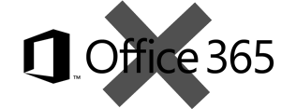
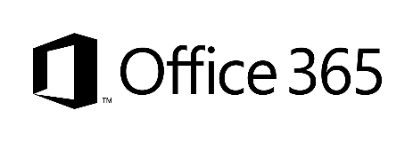
What does “app model” or “add-ins” mean in our terminology?
SharePoint Add-Ins means all operations executed outside of the server
Classic - Full trust solutions
ISV solutions
Client Side Solutions
Remote provisioning for elements
Store and corporate catalog
Add-in catalog based solution
Custom service applications
Custom WCF services
Platform level customizations to on-premises
Server side controls as JavaScript on page layouts and master pages
Embracing un-ghosted model
SP add-in dimension with provider hosted add-ins to provide new capabilities
Packaged reusable solutions built for specific functionality
SharePoint customizations, not customer specific customizations
Customer specific customizations
Not only for market place or store, but also as platform for customer specific customizations
Notes:
Just to clear out hat the app model / add-in model means in Microsoft terminology.
Key pointer to land is that there’s two types of apps… typical apps in Store and in corporate catalog and client side solutions, which remotely either configure SP sites or take advantage of the SP services.
Farm solutions are supported in SP2016, but recommended only for special cases.

Slide 8





Approaching add-in transformation
Readiness
Assessment
Planning
Implementation
Deployment
Readiness with add-in model topics
Hosting decisions
Network impact analysis
Development model readiness
Analyze existing solution usage
Analyze existing code and functionality
Concentrate on business and functional requirements, not on technology
Add-In model solution planning and design
What patterns and models are used for different solutions
What solutions can be converted to out of the box capabilities
Detailed technical planning
Actual add-in model solution implementation
Typical development process, including testing
Add-In solution deployment
Existing content retrofitting
Farm solution retraction
Time for accurate estimates

Slide 9
PnP Transformation Process - Deliverables
Readiness
Assessment
Planning
STEP 1
Empower & Plan
Add-in hosting configuration. Leverage available resources to ramp up Dev resources
Analyze solution inventory / requirements and provide guidance on solution modernization
Provide architecture design guidance for selected scenarios
Step 1 provides details on estimating following stages in detail.
Deliverable:
Successfully smoke test add-in to validate configuration
Deliverable:
Assessment report
Deliverable:
Architecture Design Report
Detailed statement of work for accurate estimates
Implementation
Deployment
STEP 2
Develop & Deploy
Jointly work on development and testing with MS partners
Deploy add-in solutions
Retract farm solutions
Repeat the process for each solution needed to be transformed.
Deliverable:
Tested solution artifacts
Deployment Guide
Deliverable:
Replace farm solution by add-in model solution
Project signoff
Notes:
Five steps divided to 2 steps.
We recommend to complete first 3 actions before making detailed estimates for the following steps. This way there’s clarity on the business requirements and future target for the customizations and concentration of the transformation actions is towards the actually needed capabilities. Key step is the assessment and to understand actual business drivers and how the application works from UI perspective. This is not 1 to 1 transformation, we rather concentrate on implementing needed functionalities using app model techniques, which could result completely different kind of implementation, so looking just the existing code is not enough.
You can use assessment tooling like SPCAF during the assessment phase to analyze the existing code and the possible transition approaches.

Slide 10
Factory based model for larger deployments
Application Transformation Factory
Initial Assessment & Rationalization
Detailed Assessment & Planning
Implementation & Deployment
Categorize
Batch 1
Batch 1
Batch 2
Batch 2
Batch n
Prioritize
Batch 2
Solution 1
Batch 3
Solution 1
…
…
Solution 1
…
Batch n
Solution n
Learnings, patterns, practices
Learnings, patterns, practices
Application assessments to define and the financial and technical feasibility of moving an application to app/add-in model, are done based on the combination of:
Using software analysis tool-sets
Application-code and -documentation reviews
Analysis sessions with application owners
Notes:
This shows possible factory based model for larger deployments with significant amount of customizations and applications to transform. Key point is to perform better initial prioritization and categorization for the application, but actual assessment and implementation phases will follow the similar process as with the smaller deployments. Solutions are looped through the process in batches based on categorization. Each iteration and batch will results additional learnings and reusable code, which will help on following batches.
Initial Assessment and Rationalization
Same as Readiness actions (#1) in the Transformation process
Detailed Assessment & Planning
Implementation

Slide 11
PnP transformation process assets
Template files
Introduction presentation
Kickoff presentation
Preparedness/Readiness presentation
Solution Assessment Report presentation and report
Solution Design Report presentation and report
Sample documents
Sample documents using imaginary Contoso company as the example reference.
Contain sample content written for the imaginary company performing transition
Note. These are reference files which you can modify as needed based on your own offering or project objectives.
Documents are provided “as is” to be used as starting point for building your own model around transformation projects

Slide 12
Usage guidance
You can use provided templates and sample documents in anyway you want to create your own offering around add-in model transformation

Slide 13

Questions?

Slide 14
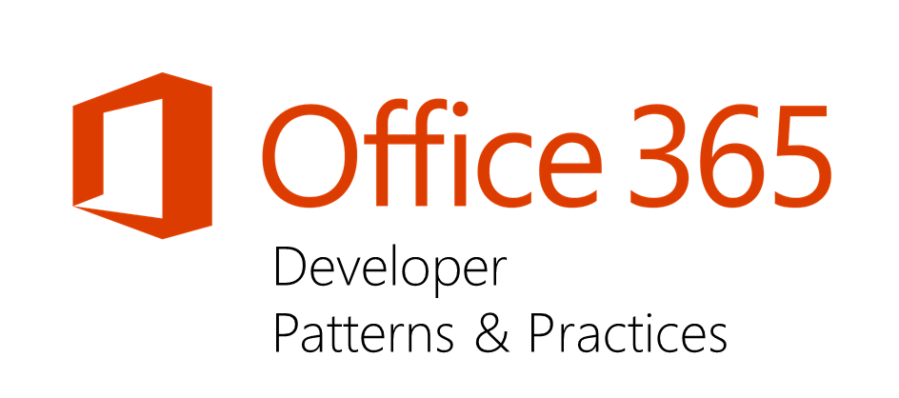
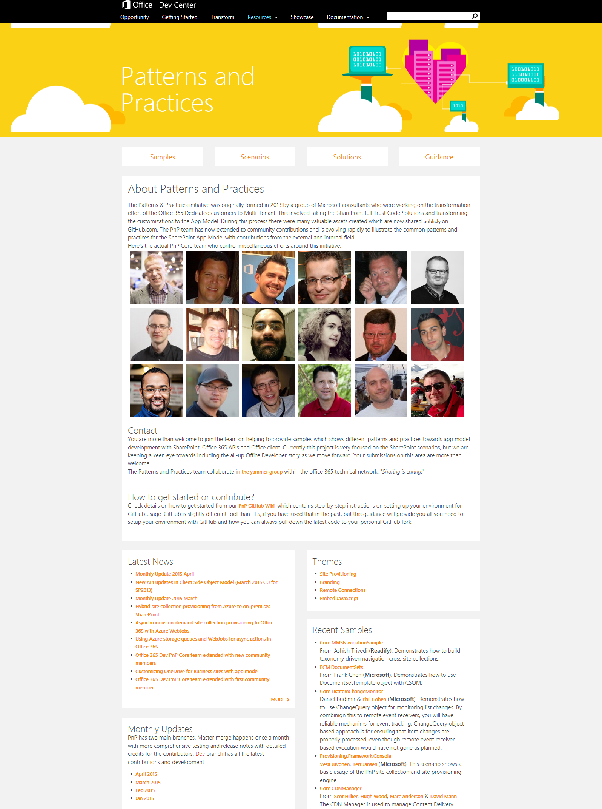
“Sharing is caring”
Ready to use add-in model patterns for common scenarios
Open source and based on community contributions
Constantly evolving set of material for reuse
aka.ms/OfficeDevPnP
aka.ms/OfficeDevPnPYammer
aka.ms/OfficeDevPnPMSDN
aka.ms/OfficeDevPnPVideos
aka.ms/OfficeDevPnPTraining

Slide 15


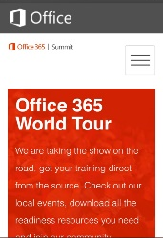
dev.office.com
Sign up
http://dev.office.com/getting-started
Explore
http://apisandbox.msdn.microsoft.com
Get trained http://dev.office.com/training

Slide 16


Feedback
Office 365 Network Share you best practices and join conversations
https://www.yammer.com/itpronetwork
Stackoverflow Ask deep technical questions to a world-wide set of developers
http://stackoverflow.com/questions/tagged/ms-office
User Voice Provide suggestions of what you want in future versions
http://officespdev.uservoice.com/

Slide 17


© 2015 Microsoft Corporation. All rights reserved. Microsoft, Windows, and other product names are or may be registered trademarks and/or trademarks in the U.S. and/or other countries.
The information herein is for informational purposes only and represents the current view of Microsoft Corporation as of the date of this presentation. Because Microsoft must respond to changing market conditions, it should not be interpreted to be a commitment on the part of Microsoft, and Microsoft cannot guarantee the accuracy of any information provided after the date of this presentation. MICROSOFT MAKES NO WARRANTIES, EXPRESS, IMPLIED OR STATUTORY, AS TO THE INFORMATION IN THIS PRESENTATION.

